Slide 1
Sessions & Login
PHP Fundamentals

Slide 2
IT1322 – Principles of Web Usability Design
PHP Sessions – Definition
A PHP session variable is used to store information about, or change settings for a user session. Session variables hold information about one single user, and are available to all pages in one application.

Slide 3
PHP Session Variables
The internet is stateless, and web server doesn’t not know who you are as the HTTP address doesn’t maintain state.
PHP session allow user to store useful information (i.e. username, shopping items, etc)
These sessions are temporary and will be deleted when the user leaves the website.
Notes:
When you are working with an application, you open it, do some changes and then you close it. This is much like a Session. The computer knows who you are. It knows when you start the application and when you end. But on the internet there is one problem: the web server does not know who you are and what you do because the HTTP address doesn't maintain state.

Slide 4
PHP Starting a session
Before you can store user information in your PHP session, you must first start up the session. The session_start() function must appear BEFORE the <html> tag:
<?php session_start(); ?> <html> <body> </body> </html>

Slide 5
Storing a Session Variable
To store and retrieve session variables is to use the PHP $_SESSION variable:
<?php session_start(); // store session data $_SESSION['views']=1; ?> <html> <body> <?php //retrieve session data echo "Pageviews=". $_SESSION['views']; ?> </body> </html>
Output: Pageviews=1

Slide 6
Storing a Session Variable Example 2
n the example below, we create a simple page-views counter. The isset() function checks if the "views" variable has already been set. If "views" has been set, we can increment our counter. If "views" doesn't exist, we create a "views" variable, and set it to 1:
<?php session_start(); if(isset($_SESSION['views'])) $_SESSION['views']=$_SESSION['views']+1; else $_SESSION['views']=1; echo "Views=". $_SESSION['views']; ?>

Slide 7
Destroying a session
If you wish to delete some session data, you can use the unset() or the session_destroy() function. The unset() function is used to free the specified session variable:
<?php session_start(); if(isset($_SESSION['views'])) unset($_SESSION['views']); ?>
You can also completely destroy the session by calling the session_destroy() function:
<?php session_destroy(); ?>

Slide 8
Login Example
After the user filled up the login form , the login will be submitted to login.php for verification. Depending on the role of the user, he or she will be redirected to see the member page or the administrator page. Session variables for the username and role will be created.
loginform.php
User enters login and password
Login.php
System checks with database to verify valid user login, also retrieve role of user, then redirects user to the appropriate page
Member Page
Administrator page

Slide 9
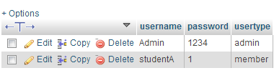
Login example – login.php
Login Table – assuming you have the following table structure and data in the database
Login.php
Step 1– retrieve the values entered in loginform.php
…… $uname = $_POST[‘formusername']; //retrieve username from previous page $pword = $_POST[‘formpassword']; //retrieve password from previous page
Notes:
The changeable values are stored in another file constants.php where they are defined, and included in the connection.php file.

Slide 10
Login example – login.php
Step 2– verifying if username and password is correct
Login.php
SQL = "SELECT * FROM login WHERE username='".$uname."'"." AND password='".$pword."'"; //construct sql query $result = mysqli_query($connection, $SQL ); $num_rows = mysqli_num_rows($result); echo "number of rows".$num_rows; //if num rows return > 0 means username & password is found => login // is successful. if ($num_rows > 0) { //start a new session session_start(); …….

Slide 11
Login example – login.php
Step 3 – Create the sessions
Login.php
if ($num_rows > 0) { session_start(); //start a new session //create a new session variable named: loginname, and pass the username to it $_SESSION['loginname'] = $uname; //retrieves the role from the $result array of the returned query while($row = mysqli_fetch_array($result)) { $roletype = $row['usertype']; } //assign result to variable $roletype //create a new session variable: userrole, and pass the roletype to it $_SESSION[‘userrole'] = $roletype;

Slide 12
Login example – login.php
Step 4 – redirect the user accordingly to his role. Note header(“Location: target.html”) is used to redirect to the target.html page.
Login.php
if($roletype=="admin") // check if $roletype == "admin" {header ("Location: adminpage.php");} //redirect to adminpage.php else { //else members are redirected to memberspage.php header ("Location: memberspage.php");} } else { // user not found or invalid login header ("Location: errorlogin.php"); // user not found, redirect to errorlogin.php }
Notes:
For full code refer to your practical solution.

Slide 13
Securing your webpage (Admin access only page)
Three possible scenerios
1 | Person did not log in | Redirect to login form
2 | Person is logged on but is a member | Redirect to denied page
3 | Person is logged on and is an admin | Allow access to this page

Slide 14
Securing a webpage (Admin access only page)
Preventing unauthorized access– Include this in every page that requires authorized access. If the person logged in is an admin userrole type, he should be able to see the html page after this set of codes.
Login.php
<?PHP session_start(); // check if user has login, if not direct user to login page if (!(isset($_SESSION['loginname']) && $_SESSION['loginname'] != '')) { header ("Location: pagelogin.php"); } // check if user is login and has admin role type, if not show access denied. elseif (isset($_SESSION['loginname']) && ($_SESSION[‘userrole']!= "admin")) { header ("Location: access_denied.php");} ?>
Notes:
Isset() is used to check if a session variable is set, if it is not set means session has not been created.
If it is set, and not = “” blank, means a session exist.
(!(isset($_SESSION['login']) && $_SESSION['login'] != '')) basically return false implies not login yet.

Slide 15
Securing a webpage – Loggin out
Logging out - Using unset will destroy the session. Thereafter allow link to another page (Eg. Home page) on the website.
<?PHP session_start(); if(isset($_SESSION['loginname'])) unset($_SESSION['loginname']); ?> <!DOCTYPE HTML> <head> <title>Logout</title> </head> <body> <h2>You have logged out</h2> <p><a href=‘homepage.php'>Return to Display Notes</a></p> </body></html>
Notes:
Using unset will destroy the session. Thereafter allow link to another page on the website.

Slide 16
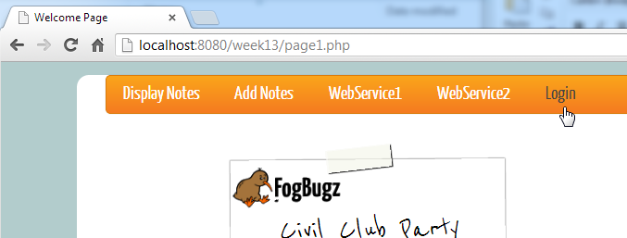
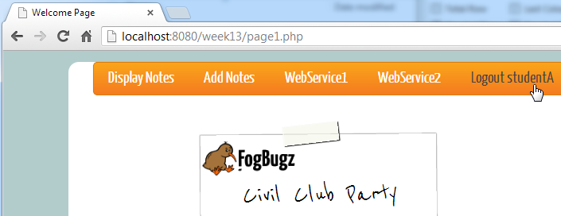
Creating Dynamic Links
How to display dynamic login or logout screen depending on the login status.

Slide 17
Creating Dynamic Links
Within the menu list item, insert php that will echo out the appropriate <a href=….></a> hyperlink tag and label, depending on if the session has been created or not.
<li> <?php if(isset($_SESSION['login']) && $_SESSION['login']!="") { // displays username echo"<a href='logout.php'>Logout ".$_SESSION['login']."</a>"; } else { echo("<a href='pagelogin.php'>Login</a> "); } ?> </li>

